Slide 1
The Battle of Neighbourhoods
Ajay Rangan Kasturirangan

Slide 2
Introduction/Business Problem
Chennai, also known as Madras is the capital of the Indian state of Tamil Nadu. Located on the Coromandel Coast off the Bay of Bengal, it is a primary cultural, economic and educational centre of South India. According to the 2011 Indian census, it is the sixth-most populous city and fourth-most populous urban agglomeration in India. The city together with the adjoining regions constitutes the Chennai Metropolitan Area, which is the 36th-largest urban area by population in the world. Chennai has an area of 1,189 km2 and a population over 8 million.
This this analysis we are going to see the feasibility of opening different cuisines of restaurants in different zones of Chennai. A zone can be treated as the equivalent of a Borough in other parts of the world. A zone contains many neighbourhoods.
This analysis will be conducted with the help of Chloropleth maps as they are easy to read and explore.

Slide 3
Introduction/Business Problem contd
So the question that will be answered is:
Which zone in Chennai sees a high frequency of restaurants?
What is the price range of restaurants by zone?
What is the popularity of a particular cuisine by zone in Chennai?
Which Zones in Chennai have similar characteristics based on restaurants they contain? This will help people to explore new markets for different cuisines.

Slide 4
Data
Restaurant data:
https://www.kaggle.com/phiitm/chennai-zomato-restaurants-data?select=Zomato+Chennai+Listing+2020.csv
Geodata:
https://raw.githubusercontent.com/datameet/Municipal_Spatial_Data/master/Chennai/Zones.geojson

Slide 5
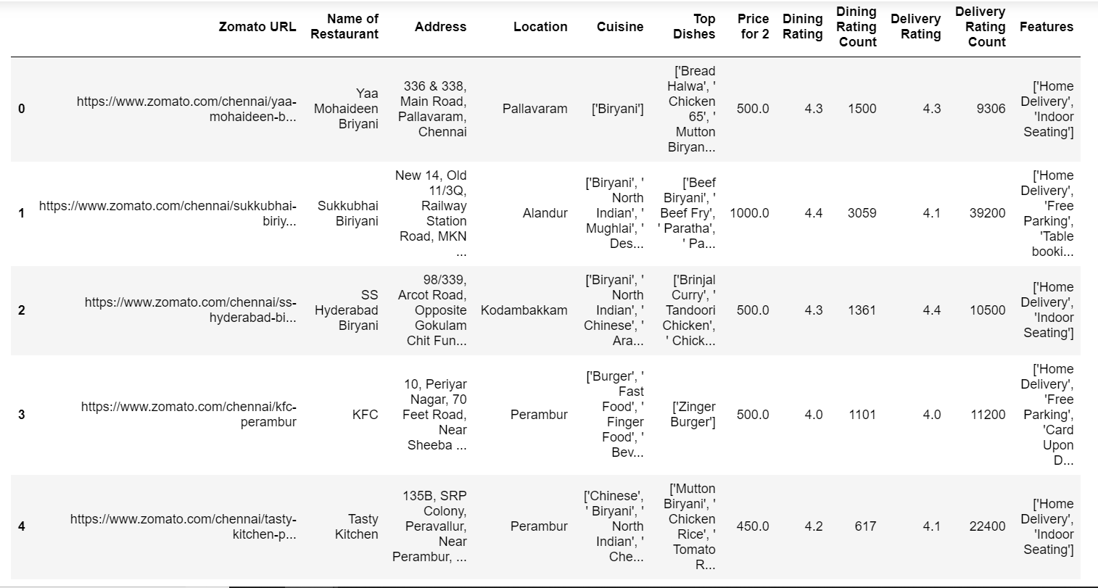
Methodology
Import data of all restaurants.

Slide 6
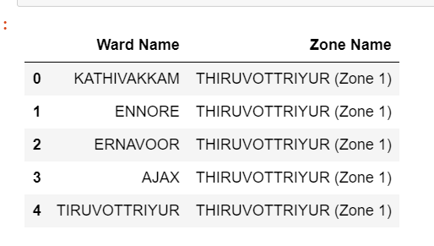
Methodology contd
Import Neighbourhood data
Clean the data to obtain a data frame comfortable to work with
Plot Chloropleth Maps for understanding the data and answering the questions posed. These maps can be inferential for the question under consideration and exploratory with reference to the upcoming questions.

Slide 7
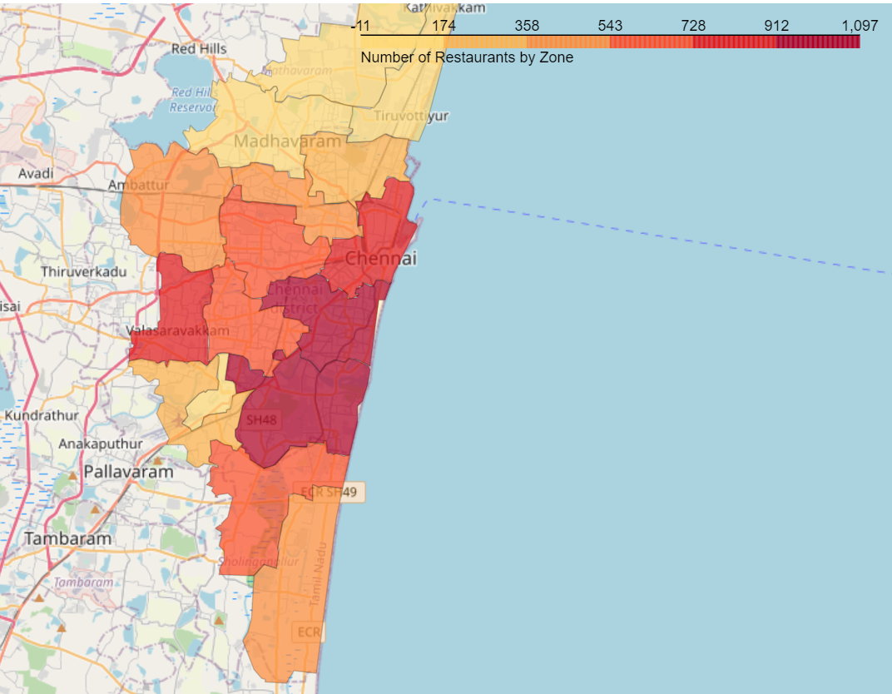
Maps

Slide 8
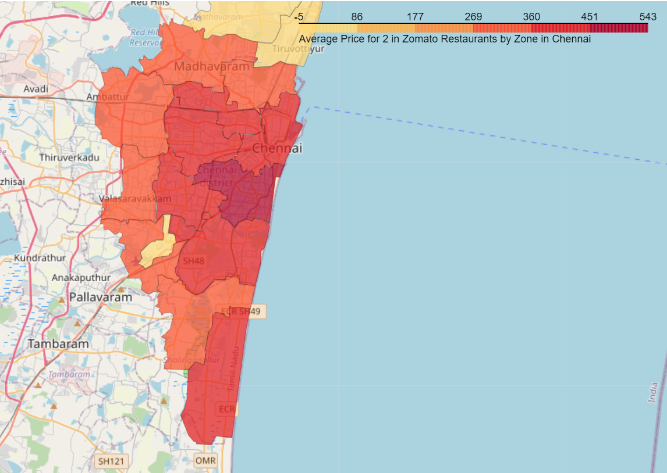
Maps

Slide 9
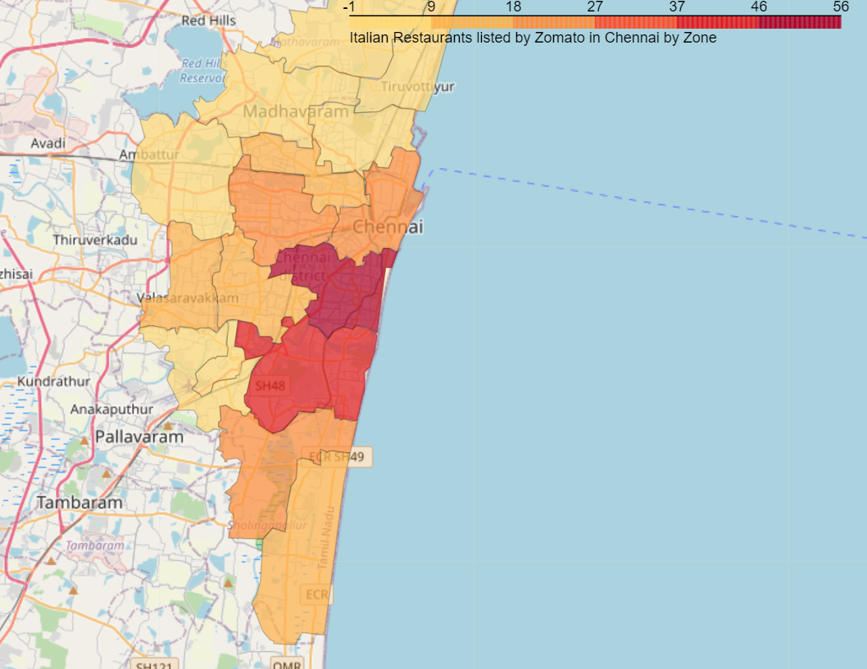
Maps

Slide 10
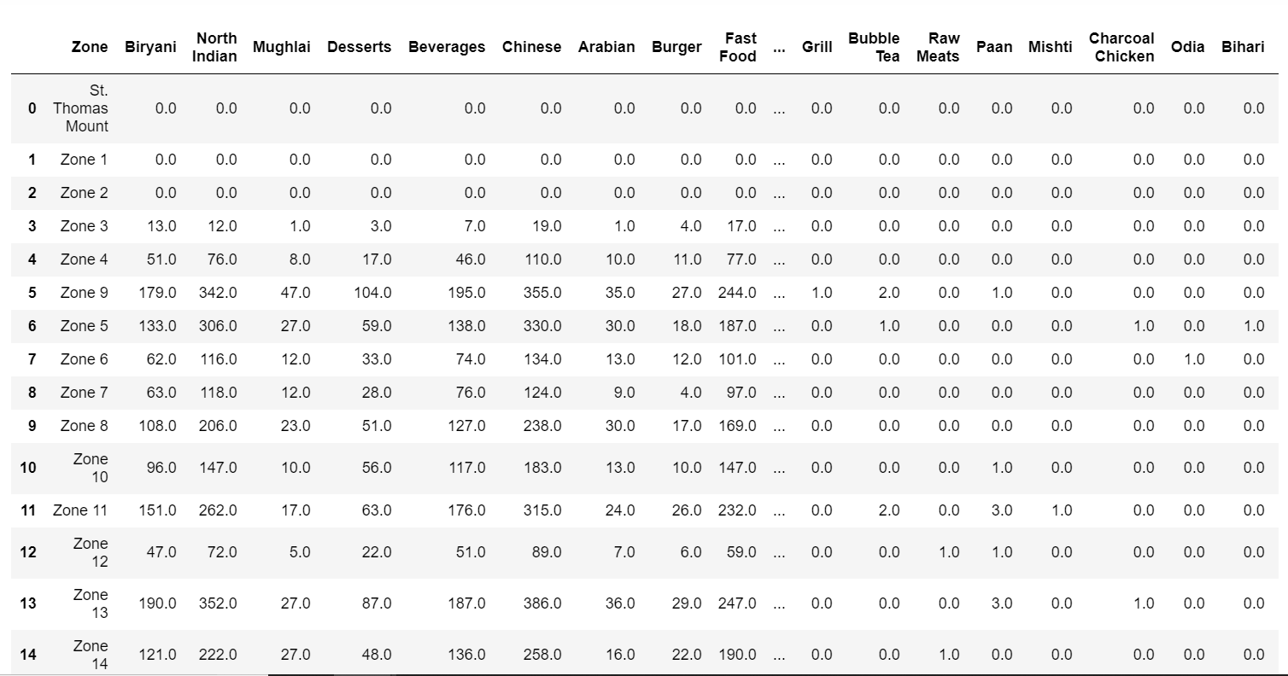
Methodology
Create a dataframe suitable to perform KMeans Clustering to identify similar neighbourhoods.
Perform KMeans Clustering to cluster the Zones

Slide 11
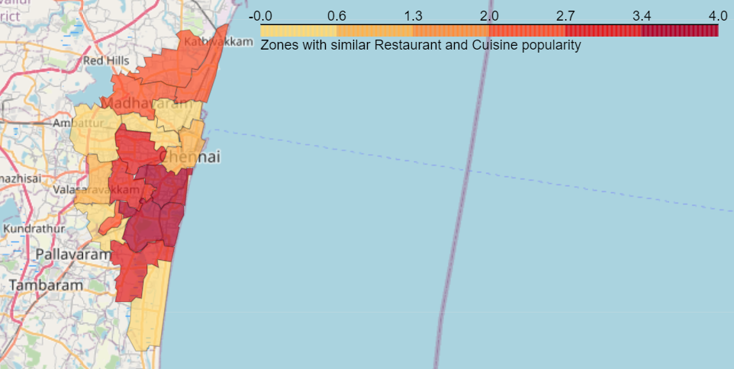
Cluster Map

Slide 12
Results:
In the map we observe many patterns for different cuisines in the city. We can observe which zone in Chennai sees a high frequency of restaurants. We can see the price range of restaurants by zone. We can see the popularity of a particular cuisine of choice by zone in Chennai. We also observe 5 clusters of zones by cuisine popularity

Slide 13
Discussion
Some interesting observations we can see from the maps are
Average price in restaurants decreases concentrically as we move away from the city centre. North Indian Cuisine is move popular near the beaches. Most foreign cuisine is popular only in the central zones. Given the popularity of some restaurants in zones as seen on the map we can extrapolate and show other zones where they may be popular.

Slide 14
Conclusion
The Code can be used to figure out the feasibility of opening a restaurant of a particular cuisine in a particular Zone.

